Slide 1
World Stock Data Visualization Dashboard
Prepared by: Sujeet Nirmal Jawale
Date: 01 March 2024

Slide 2
Table of Contents
Introduction
Objective
Audience
Dashboard:
Stock Price Analysis Dashboard
Analysis of Dividends and Splits
In-depth Analysis of World's Stocks

Slide 3
Introduction
‘World Stock Price Analysis Dashboard’, an interactive and real-time analytical tool designed to empower investors, analysts, and financial professionals with actionable insights into the global stock market. In an environment where seconds can mean significant financial shifts, our dashboard provides a crucial edge by presenting comprehensive stock price metrics, trend analyses, and industry comparisons through an intuitive interface.

Slide 4
Objective
To deliver a state-of-the-art platform that not only simplifies complex data but also elevates the decision-making process. Whether you're tracking the performance of individual stocks or assessing the health of entire sectors, this dashboard is your window to the pulse of the market.

Slide 5
Audience
Financial Analysts: Professionals who analyze financial data to make predictions about stock performance and provide investment guidance.
Portfolio Managers: They make investment decisions and manage investment portfolios, using stock data to balance risk and reward according to client mandates.
Stock Traders: Individuals who buy and sell securities for themselves or for their clients.
Financial Educators and Students: Instructors and students studying finance who can use real-world data for educational purposes.
Financial Journalists: Reporters who analyze and report on stock market trends for their audience.

Slide 6
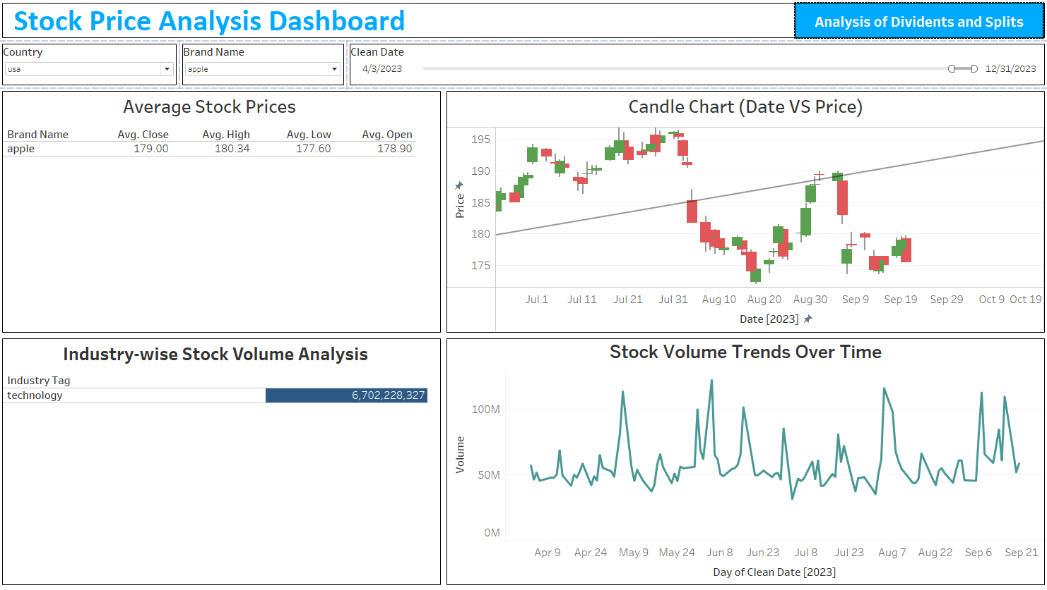
Dashboard 1

Slide 7
Dashboard 1
Multi-Dimensional Filters:
The dashboard includes interactive filters for 'Country', 'Brand Name', and 'Clean Date', allowing users to refine the stock data displayed. This customization enables a targeted analysis of stock performance for specific companies like 'apple' within a chosen market like 'usa' and for particular dates, ensuring users can quickly focus on the most relevant information.
Average Stock Prices:
A concise table presents the average closing, high, low, and opening prices for the selected stock, giving a snapshot of its recent performance. For instance, 'apple's stock prices are neatly summarized, providing investors with a quick overview of market activity and aiding in the assessment of the stock's stability and volatility.
Candle Chart (Date vs. Price):
A detailed candlestick chart offers a visual representation of price movements over time, depicting the daily high, low, opening, and closing prices. The chart is a valuable tool for technical analysis, revealing patterns and trends in 'apple's stock price, and includes a timeline that appears to run from August of the previous year to February of the current year.

Slide 8
Dashboard 1
Analysis of Dividends and Splits Feature :
A button titled 'Analysis of Dividends and Splits' allows quick access to a second dashboard, offering insights into a company’s dividend distributions and stock split history, essential for evaluating a stock’s investment potential.
Volume Analysis and Trends:
The dashboard features two key volume insights: an 'Industry-wise Stock Volume Analysis' showing total trading volume within a selected industry, such as 'technology', and a 'Stock Volume Trends Over Time' chart displaying the fluctuations in trading volume over the course of the year. These tools help users to gauge market sentiment and liquidity, potentially indicating periods of accumulation or distribution.

Slide 9
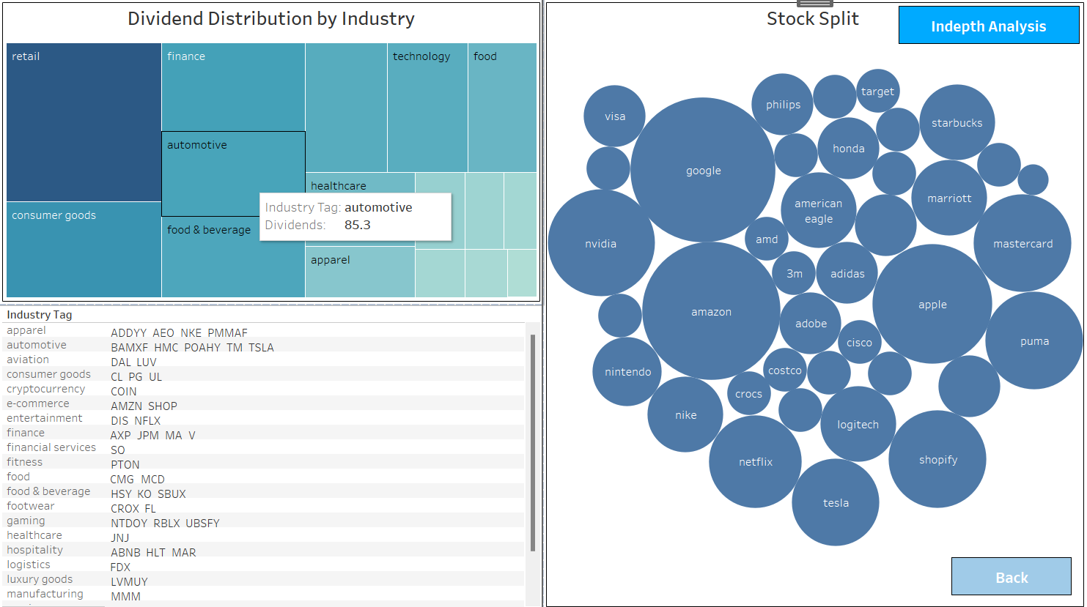
Dashboard 2

Slide 10
Dashboard 2
Dividend Distribution by Industry:
A tree map visualizes dividend distributions, categorizing companies by industry, such as retail, finance, and technology, allowing for a quick comparative view of dividend payouts across sectors. It also has an highlight action with the Industry – Ticker Visualization.
Stock Visualization:
A bubble chart represents stock splits, with each bubble's size reflecting the frequency or magnitude of splits for companies like Apple, Amazon, and Google, offering insights into historical stock split patterns. Consist an URL action to display information about the company.
Navigation and In-Depth Analysis:
A button marked 'In-depth Analysis' leads to a more detailed examination of the data, while a 'Back' button provides easy navigation to return to the previous dashboard.

Slide 11
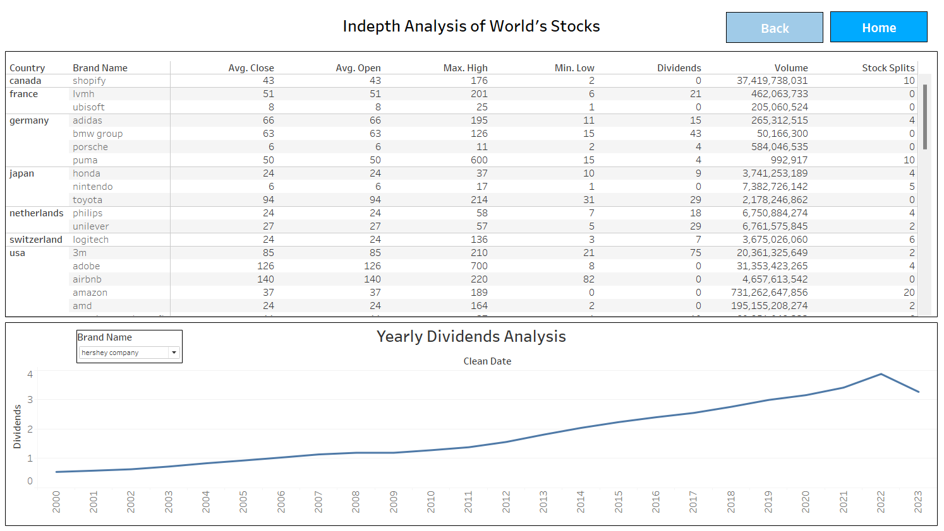
Dashboard 3

Slide 12
Dashboard 3
Global Stock Overview:
The table lists stocks from various countries, offering a global perspective on market performance with brand names like Shopify, LVHM, and Adidas being analyzed.
Yearly Dividends Analysis:
A line chart tracks the trend of dividend payouts over time, with a clear axis from the year 2000 through 2023, highlighting changes and trends in dividend distributions which can be important for long-term investment strategies.
Historical Dividend and Split Data:
The table includes historical data on dividends and stock splits, crucial for assessing a company’s long-term shareholder value and investment suitability
Navigation Controls:
Buttons labeled 'Back' and 'Home' allow users to easily navigate between the detailed view and other sections of the dashboard, enhancing user experience and interaction.

Slide 13
Key Features
Designed with our end-users in mind, each dashboard is tailored to provide a seamless and intuitive experience, ensuring that relevant information is just a click away.
Through interactive elements such as filtering and drill-down capabilities, we've ensured that each user can personalize their analytical journey.
Also has actions such as Highlights and URL to get more in-depth information from the data.

Slide 14
Conclusion
Our dashboard serves as a beacon in the complex sea of data, guiding stakeholders through the nuanced ebb and flow of market trends, financial forecasts, and multimedia analytics. It stands as a testament to the power of visual storytelling, where each chart and graph narrates the story of numbers with clarity and purpose. As we continue to harness the potential of data visualization, let us embrace the insights revealed by our dashboard, driving informed decisions and strategic initiatives.

